Slide 1
health system and health policy developments in Georgia, including current state of UHC
Ministry of Labour, Health and Social Affairs
February, 2019

Slide 2

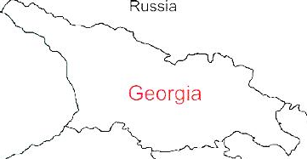



Demographic and Socio-Economic Situation, 2017
Population – 3 728 300
Birth rate (per thousand population) – 14.3
Mortality rate (per thousand population) – 12.8
Life expectancy at birth – 73.5
Maternal Mortality (per 100000 live birth) – 13.1
Infant mortality (per 1000 live birth) – 9.6
Under 5 mortality rate (per 1000 live birth) – 11.1
GDP per capita (at current prices) – 4067 $US
GDP real growth – 5.0%
Government expenditure on health per capita – 104 $US
Government expenditure on health as % of GDP – 2.8%
Government expenditure on health as % of State Budget – 8%
Government expenditure on health as % of GDP – 3.1%
General Government expenditure on health per capita (USD) – 117
Notes:
The population of Georgia has declined during the last 25 years, largely due to the outmigration and according to the census conducted in 2014, it is 3,7 mln.
Georgia has made a good progress in improving health outcomes. Life expectancy has increased by about 5 years over the few decades and currently is at 73.5 years.
Significantly has declined under-five mortality and infant mortality
In 2015 Georgia met MDGs 4th Goal: decrease under-5 mortality rate

Slide 3
Universal Health Care – Socially Oriented Political Platform
Reforms have moved Georgia closer to universal health coverage
Unprecedented Expansion of State Budget for Health care
365 mill GEL in 2012 → 1112 Mill Gel in 2017
Launch of Universal Health Care Program in February 2013
Better access to care
Better user experience
Better financial protection

Slide 4
Health sector expenditures
Out-of-Pocket Payment as % of Total Health Expenditure, Georgia
Public Health Expenditure, Georgia
Source: Georgia NHA 2010-2016 (MoLHSA, 2017)
Notes:
The UHC program was accompanied with a substantial increase in the governments budget allocations. From 2012 to 2016, the health budget more than doubled, as a percentage of GDP it increased from 1.7 percent to 3% in 2016.
The share of the out-of-pocket payments in total health expenditures has significantly decreased from 73% (in 2012) to 56% (in 2016), mainly due to the lower cost of hospitalization, which is a direct consequence of the universal healthcare program.

Slide 5
Coverage of Healthcare services
Services utilization
Hospitalization per 100 population
UHC Program has led to a major expansion in population entitlement to publicly financed health services (HUES)
Ambulatory care visits per person per years
Notes:
The coverage of population improved as demonstrated by the series of health care utilization and expenditures surveys. Over half of the population were covered first time. We have seen a surge in utilization of the health care services. Utilization of outpatient and inpatient care has almost doubled since the introduction of the UHC program.
. In Georgia, during last 2 decades, this indicator did not exceed 2.2. In the frame of the UHC programme the numbers of out- and in-patient encounters continued to grow due to increased accessibility of healthcare services. In 2016, the number of contacts with out-patient facilities per capita reached 4.0.

Slide 6
Expanding benefits
I Phase - 28 February 2013 (minimum package)
- Planned ambulatory care
- Urgent outpatient and inpatient care
II Phase - July 1, 2013 (basic package)
- Planned ambulatory care
- Urgent outpatient services
- Urgent inpatient and critical are
- Elective surgical care
- Chemo-, hormone- and radiotherapy
- Maternity services
- Basic drugs for target groups
III Phase - May 1, 2017 - Service stratification according to revenue groups using “social justice approach”
- Outpatient drugs benefit for chronic conditions

Slide 7
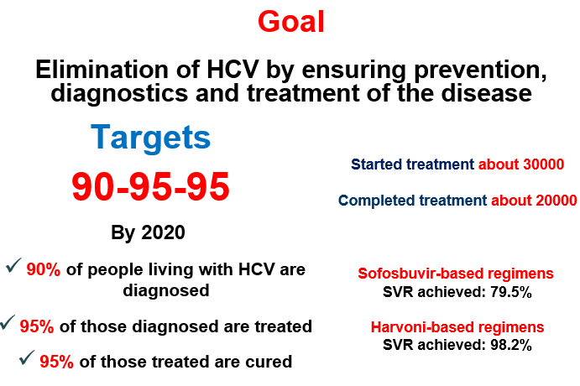
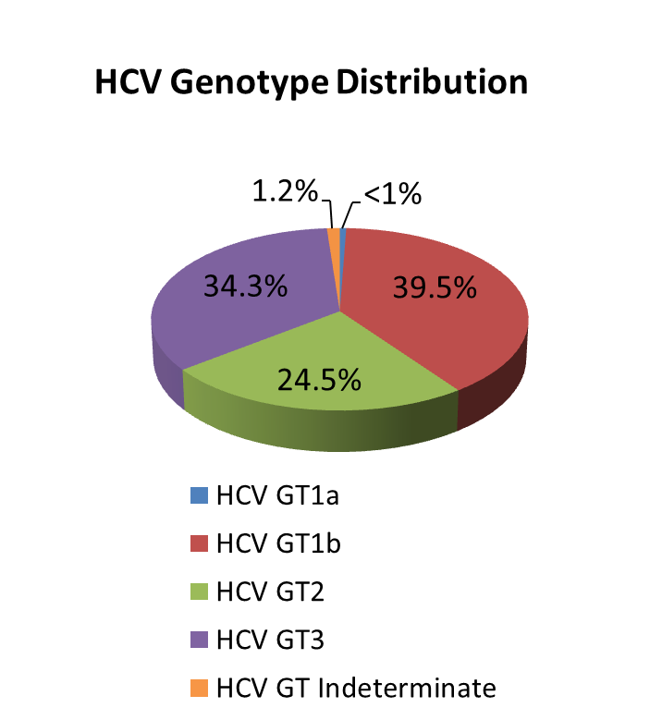
National Hepatitis C Elimination Strategy
Nationalwide survey, 2015
Anti-HCV+ | 7.7%
HCV RNA+ | 5.4%
Screened - 2 373 372
Started Treatment – 51 879
Completed treatment – 47 950
Harvoni-based regimens
SVR achieved: 98%

Slide 8



State program providing drugs for chronic conditions
2017
Chronic Cardiovascular Diseases
Chronic Obstructive Pulmonary Disease
Diabetes (type 2)
Thyroid conditions
2018
Parkinson
Epilepsy
Socially Vulnerable Families (<100 000 rating score) – less than 1 GEL
Pensions and Disabled persons
50%-80%-Discount

Slide 9
Main Challenges and future plans…
▪ Still very low public spending on health
Government annually is increase public investment in health care
▪ Expenses on outpatient medications are high
Already started and is continuing expand access to outpatient drugs
▪ Purchasing strategies need improvement for ensuring quality and containing costs
Implement of active purchasing, selective contracting and performance based financing
Notes:
High OOP Payments are a Risk Factor for Impoverishment
Population ageing + weak management of NCDs + inefficient service delivery structure ➔ are the mix of cost drivers
40% of total health spending on pharmaceuticals and most of this is paid for out-of-pocket
We are not just looking at finding additional resources but also trying to understand constraints, and employ efficiency savings: get better value for money from existing resources.
SSA is a single purchaser and needs to fully exploit its purchasing power. Need to move away from passive purchasing: selective contracting, performance monitoring, make better use of information and health information systems broadly
Extend coverage of cost-effective outpatient medicines for better health, wealth and value

Slide 10
Priority directions for the development of the healthcare sect
Health in all policies – general state multi-sectoral approach.
Development of the healthcare sector governance.
Improvement of healthcare financing system .
Development of quality medical services.
Development of human resources in the healthcare sector.
Development of health management information systems.
Support of maternal and child health.
Improvement of prevention and management of priority communicable diseases.
Improvement of prevention and control of priority non-communicable diseases.
Development of public health system

Slide 11
Health system development strategy 2019-2030
EU technical Support - Short-term Experts Deployment
Provide a set of recommendations based on the needs of the Ministry of Laboiur, Health and Social Affairs as well as their findings;
Advice on priority areas to be incorporated in the ministerial strategy document

Slide 12
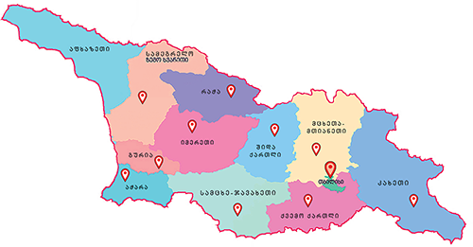
Maternal and Child Health
Georgia Maternal & Newborn and Reproductive Health Strategy 2017-2030 and Action Plan 2017-2019
Perinatal Care Regionalization - “gold” model of maternal and new born service organization
Congenital syphilis and mother-to-child transmission (MTCT) of HIV elimination plan
Universal newborn hearing screening program
Essential Nutrition Action Plan - folic acid and iron supplements for all pregnant women, breastfeeding promotion, multiple micronutrient supplementation for 6-23 months children
Under UHC program selective contracting for childbirth & C-section and neonatal intensive care services

Slide 13

Health management Information system
▪ Electronic system and regulatory mechanisms for vital events registration (since 2011)
▪ Electronic case-based reporting systems for in- and outpatients in health-care institutions (since 2014)
▪ Population-based cancer registry (since 2015)
▪ Birth registry - new electronic registration for antenatal and obstetric services and the surveillance of maternal and child health (since 2016)
▪ E-prescription (2017)
▪ Electronic health records (2019)

Slide 14
Future Plan
Working on:
Health system development strategy
PHC system development strategy
Mental Health system development action plan
Strategic Purchasing implementation action plan
DRG system implementation action plan

Slide 15
Thank you for your Attention!

